Slide 2
"Self-perception of high expertise increases closed-mindedness."
- Victor Ottatia, Loyola University
(AKA: I already know it all)

Slide 3
You Are The Expert
You are already good at what you do, now let’s help you get more out of the time you already spend on your teams.

Slide 4
How Do I Use My Data?
Training Targets Use recent data to set targets for practice sessions.
Practice Adaptation Grade yourself, and adapt practices based on reality.
Competition Goals Predict with training results and competition history.
Long Range Planning Season comparisons allow us to plan for growth.

Slide 5
Training Targets
Use recent data to set targets for practice sessions.
Track improvement to set better target times.
Compare across distances to find strengths.
Compare across reps for strength metrics.
Compare athlete performances for placement.

Slide 6
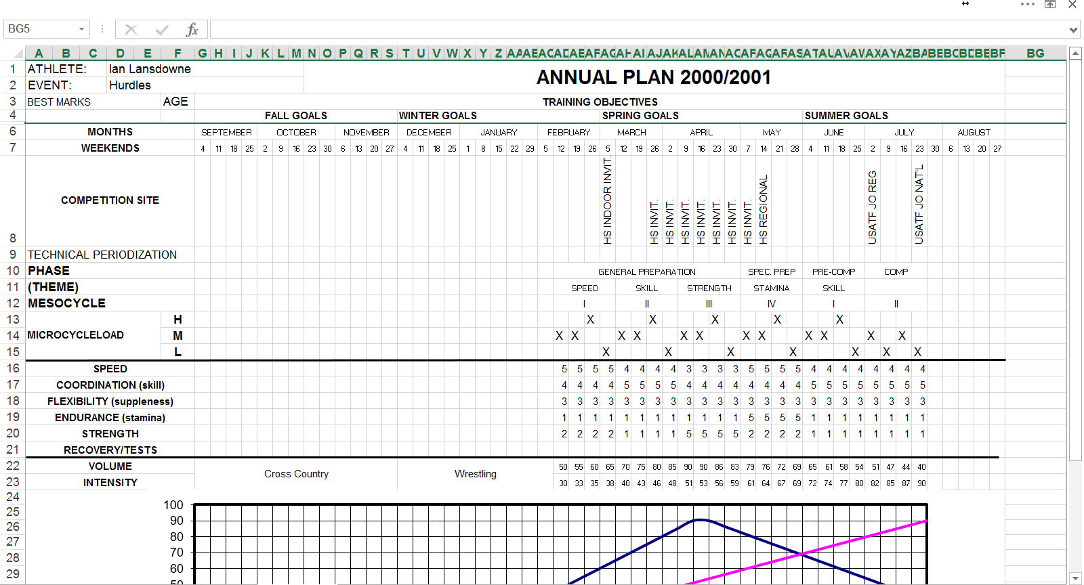
Annual Plan With Periodization

Slide 7
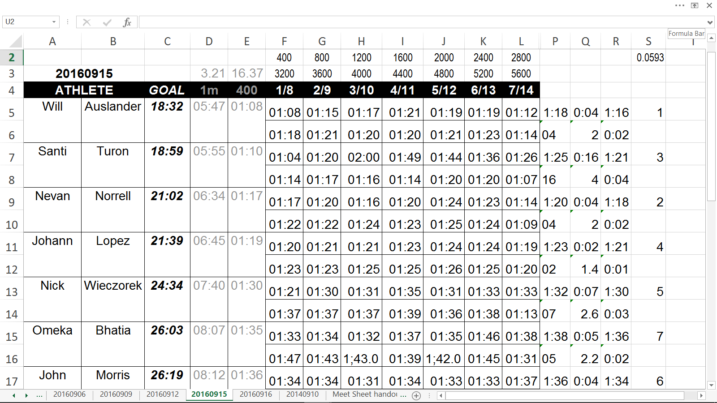
Practice Session Data

Slide 8
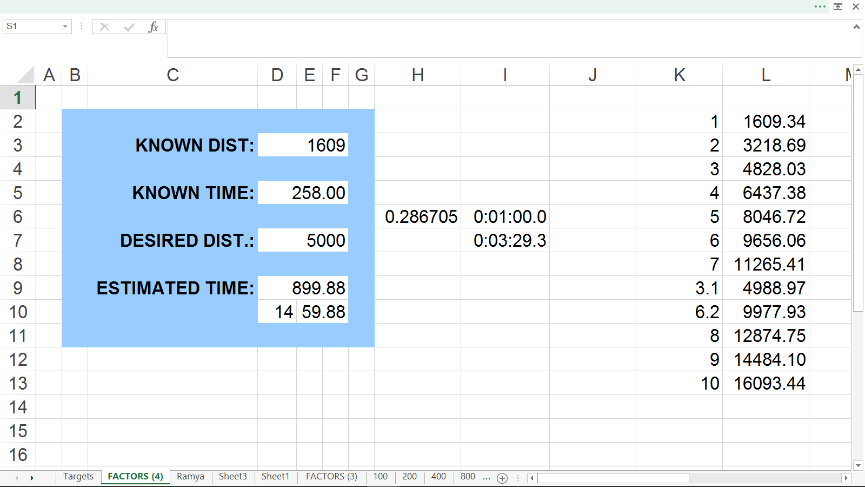
“Distance Factors” Spreadsheet (conversions)

Slide 9
Practice Adaptation
Grade yourself, and adapt practices based on reality.
Compare expectations to reality - and adjust.
Compare peaking strategies for success.
Include strength and cross training measures.
Measure intangibles (complaints, indifference).

Slide 10
Annual Plan With Periodization

Slide 11
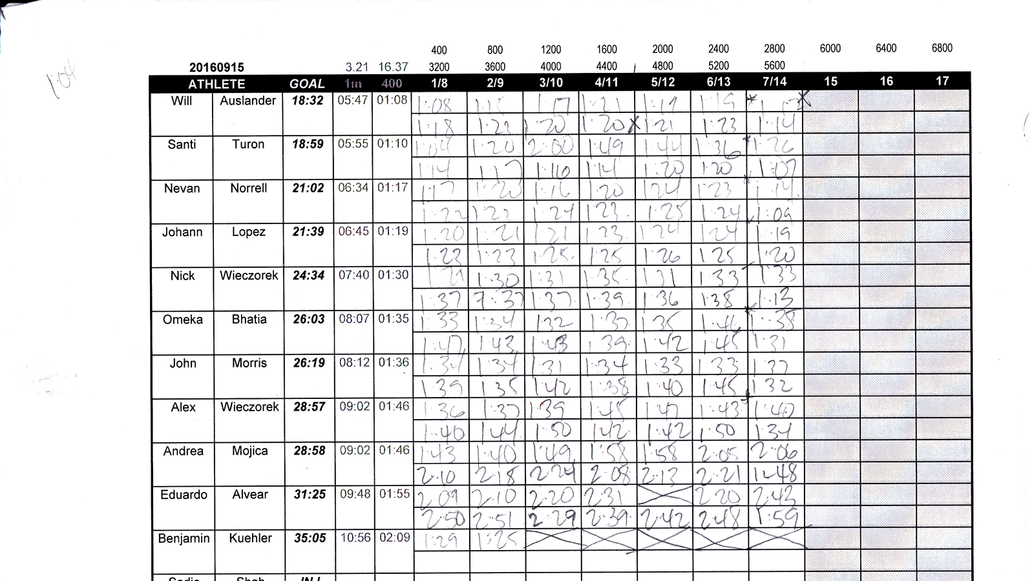
Ranking Data and/or Course Comparison

Slide 12
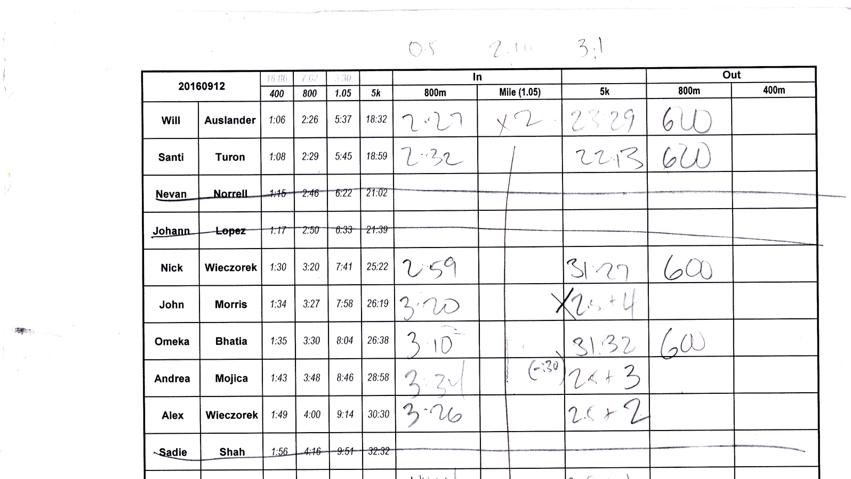
Ranking Data and/or Course Comparison

Slide 13
Competition Goals
Predict with training results and competition history.
Compare similar workouts for improvement.
Compare training to competition for value.
Use performance trends to set goals.
Use meet data for athlete scheduling.

Slide 14
Annual Plan With Periodization

Slide 15
Visual Calendar (SEE when competitions occur)

Slide 16
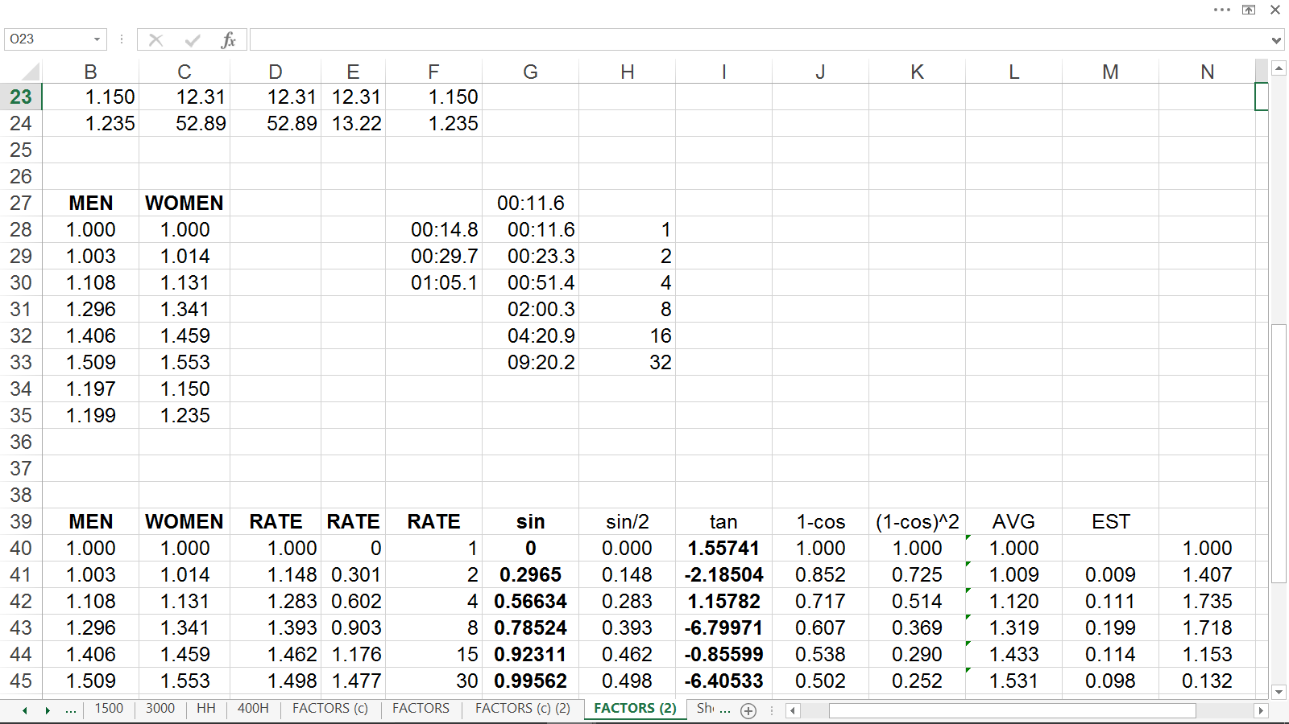
Elite Performance Averaging (formula building)

Slide 17
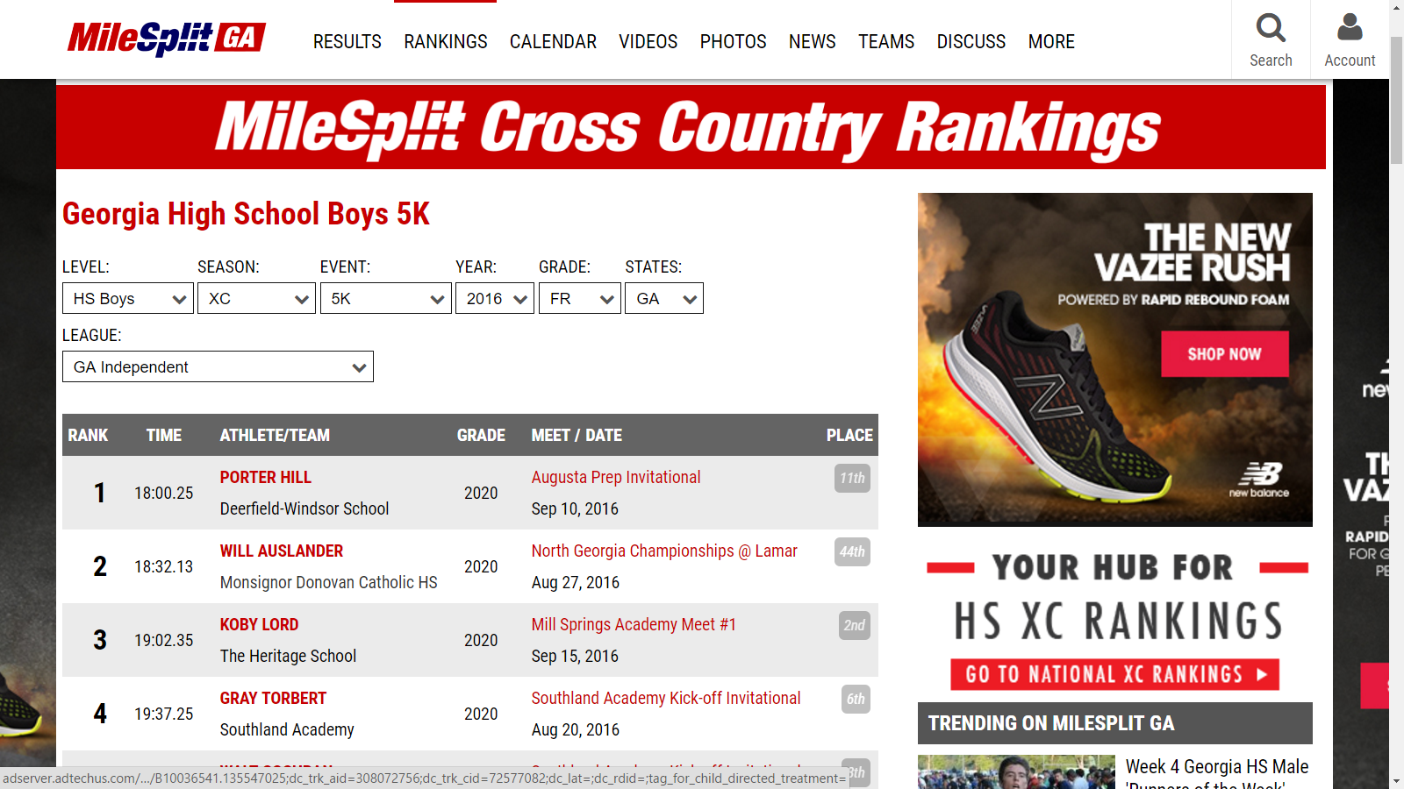
Ranking Data and/or Course Comparison

Slide 18
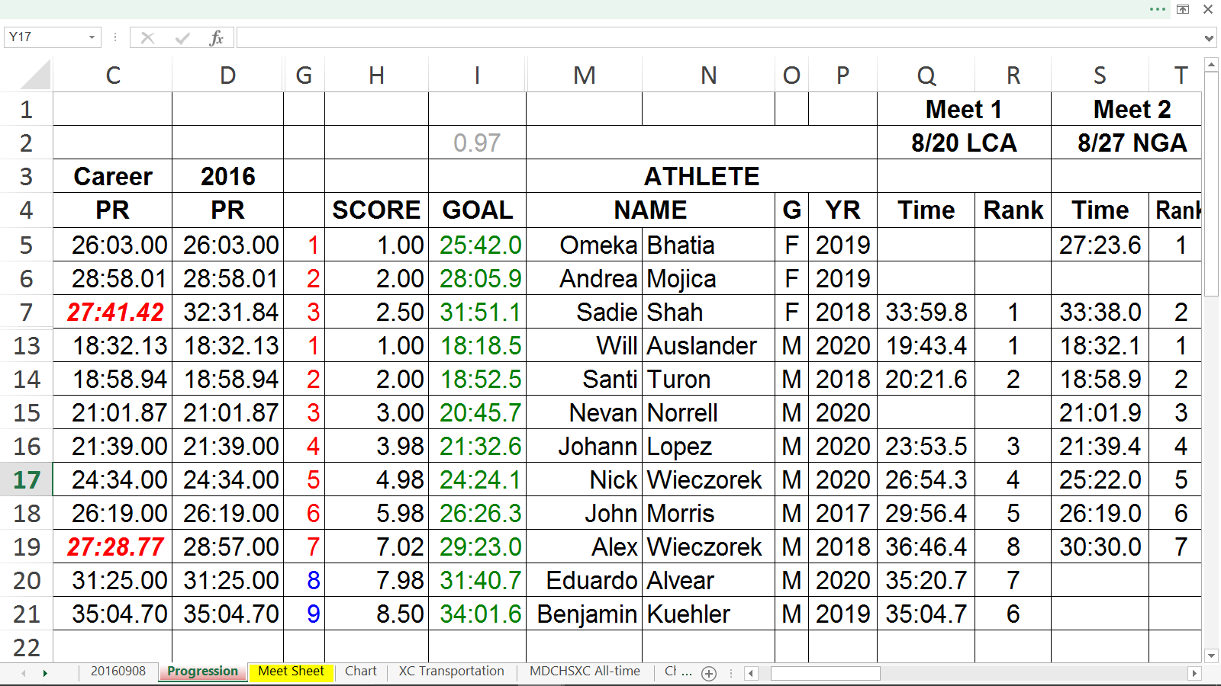
Competition Data (including predictive targets)

Slide 19
Long Range Planning
Season comparisons allow us to plan for growth.
Compare athletes season-by-season.
Compare event groups to find trends.
Compare meets for a productive schedule.
Compare peaking for effective coaching.

Slide 20
Annual Plan With Periodization

Slide 21
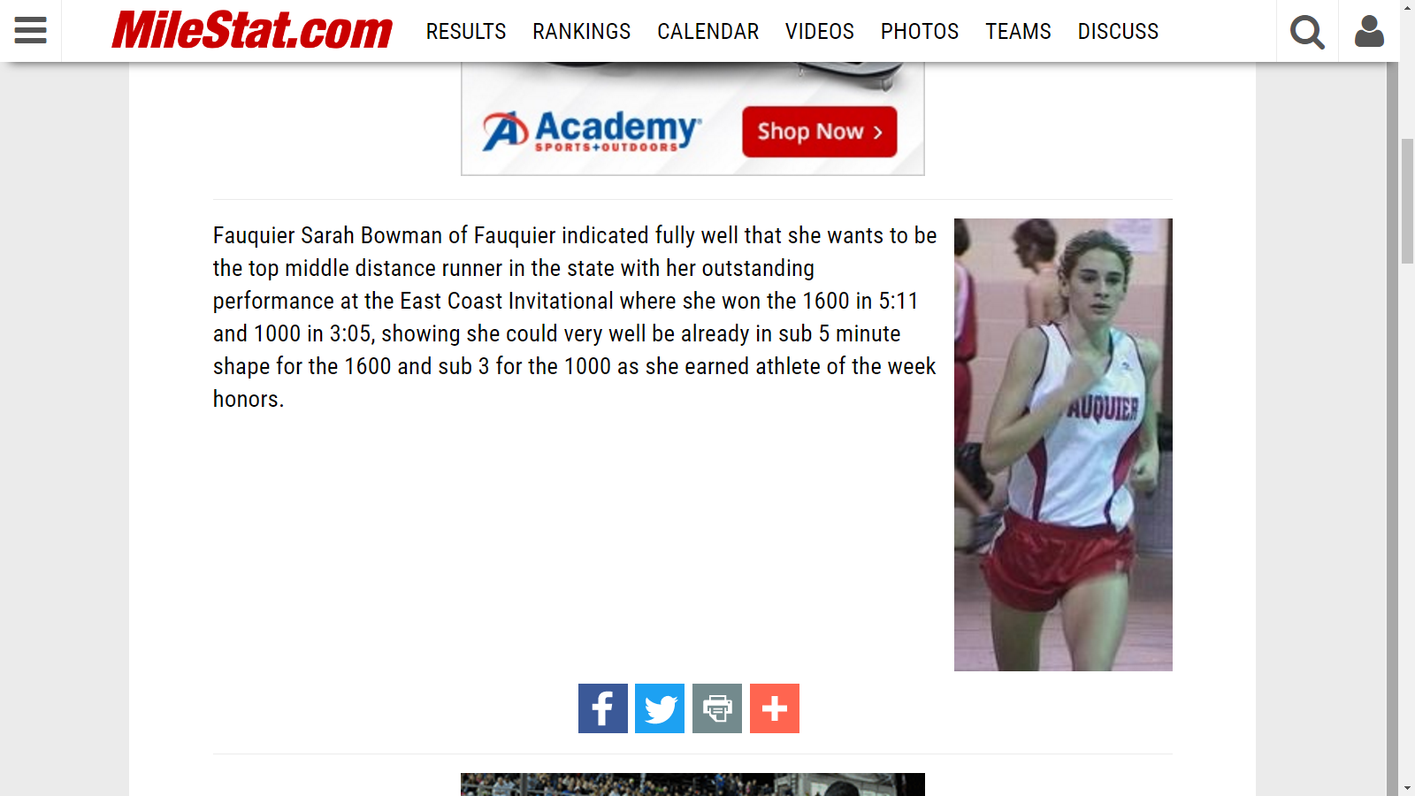
Personal Observations by Others

Slide 22
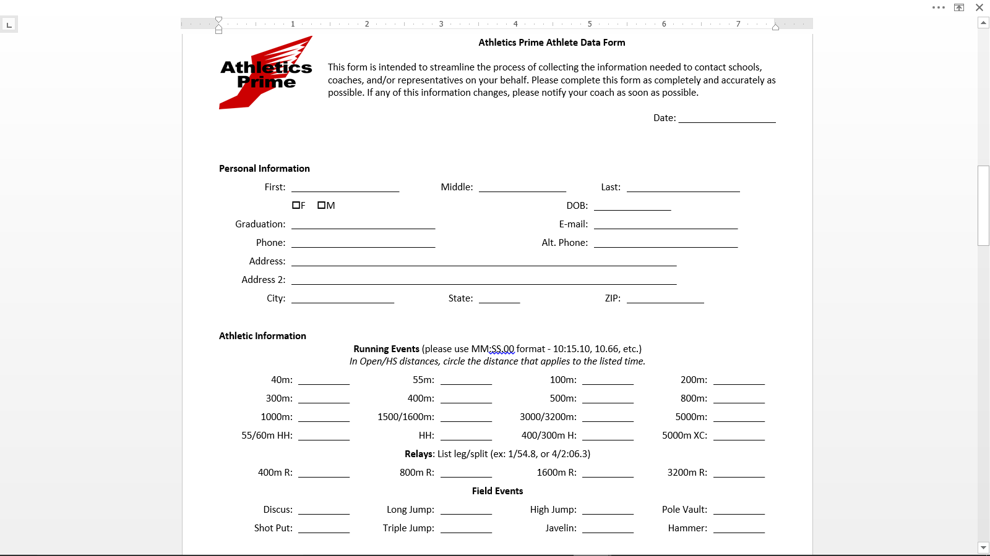
Athlete Data Form (pre-season)

Slide 23
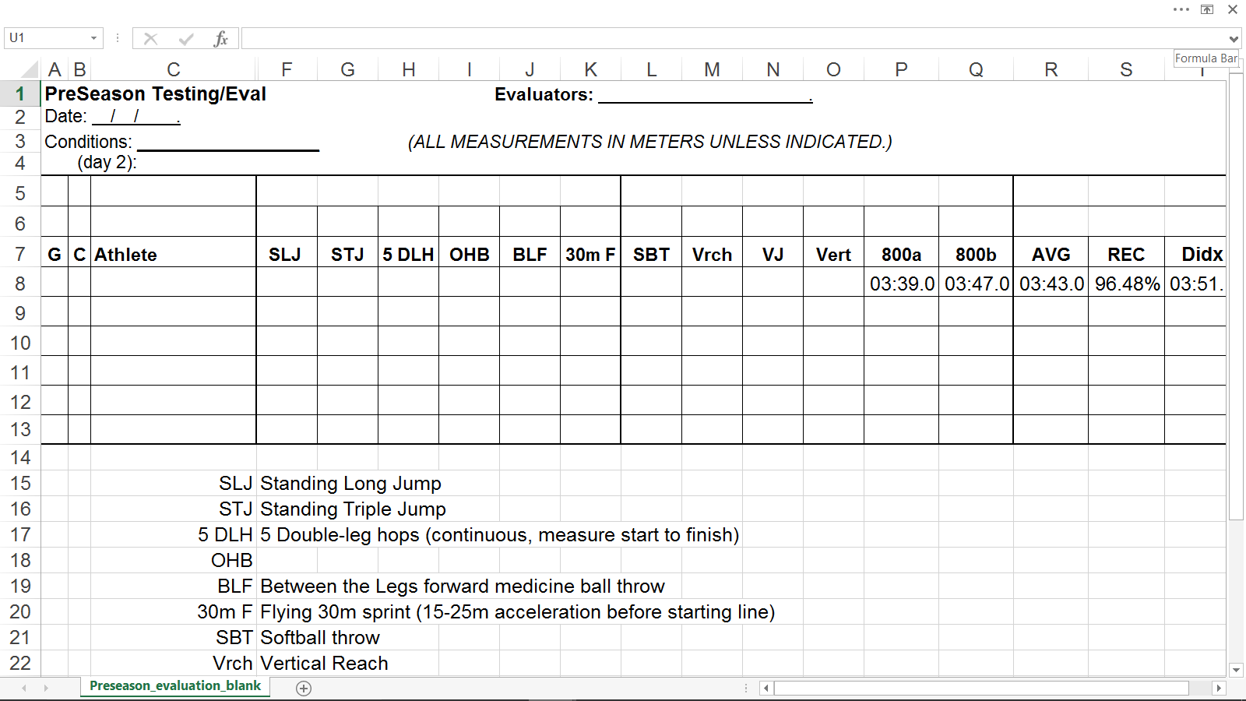
PreSeason Testing and Evaluation

Slide 24
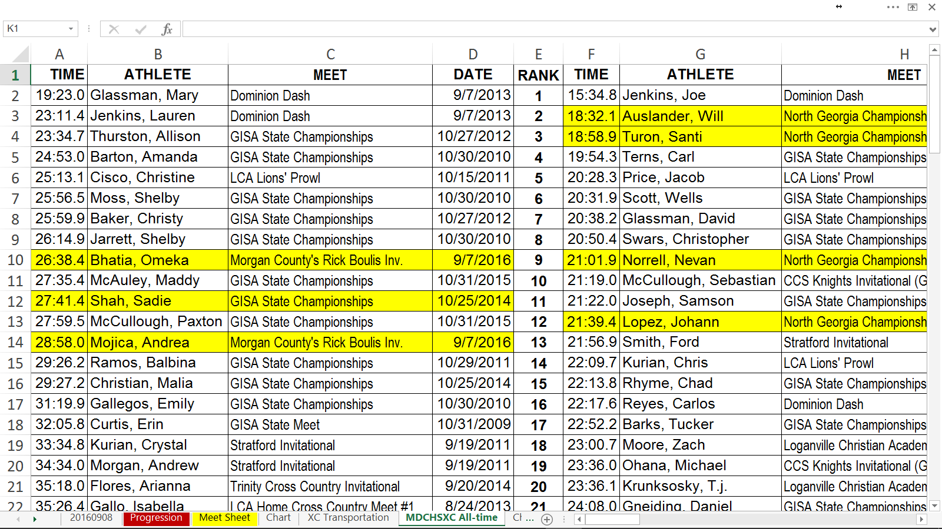
Program Historical Data (All-Time List)

Slide 25
How Do I Use My Data?
Training Targets Use recent data to set targets for practice sessions.
Practice Adaptation Grade yourself, and adapt practices based on reality.
Competition Goals Predict with training results and competition history.
Long Range Planning Season comparisons allow us to plan for growth.

Slide 26
You Are The Expert
You are already good at what you do, now be courageous enough to become even better.
Plan, execute, adapt.
Notes:
Annual Plan, Annual Plan, Annual Plan

